Slide 1

Accounting Principles & Conventions
Year 11 Willetton SHS 2023

Slide 2
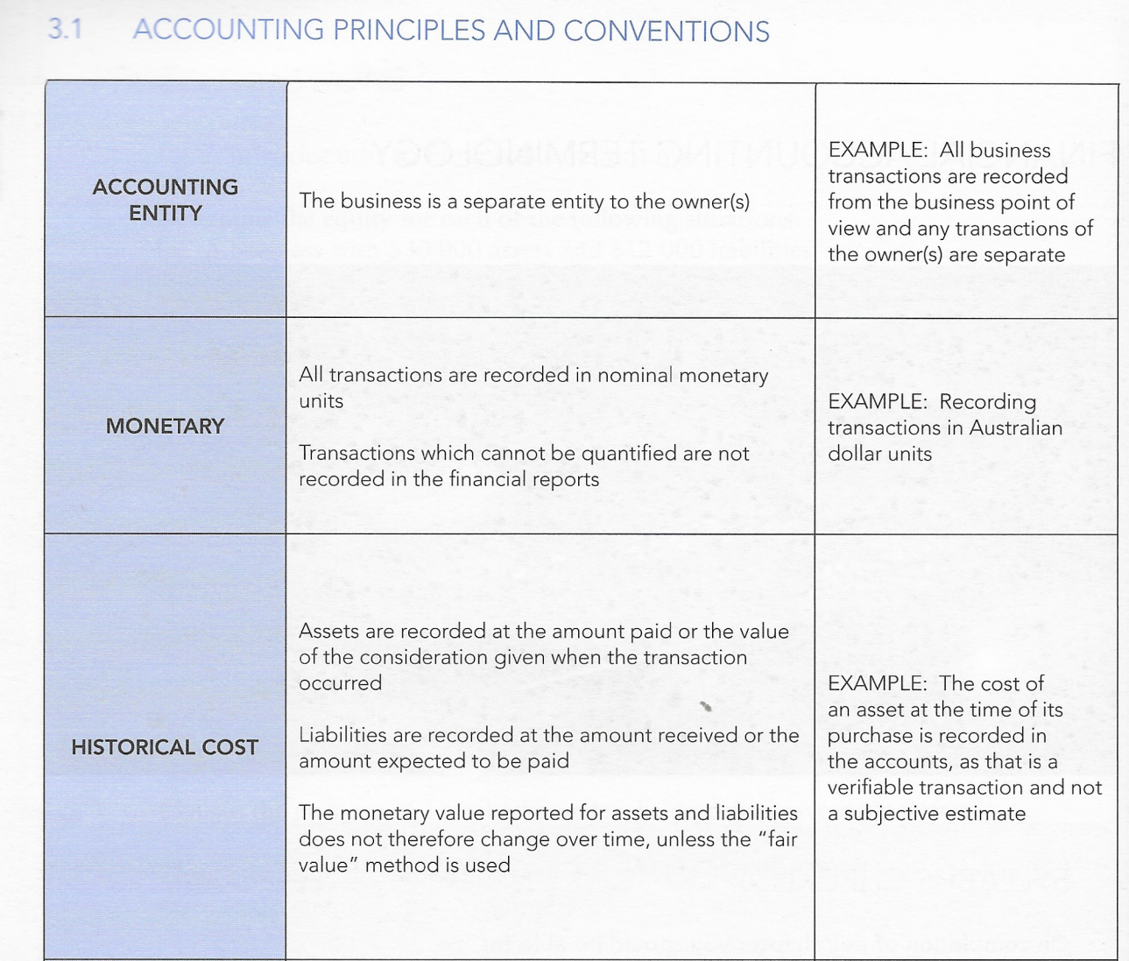

Agenda
Topic one
Topic two
Topic three
Topic four

Slide 3
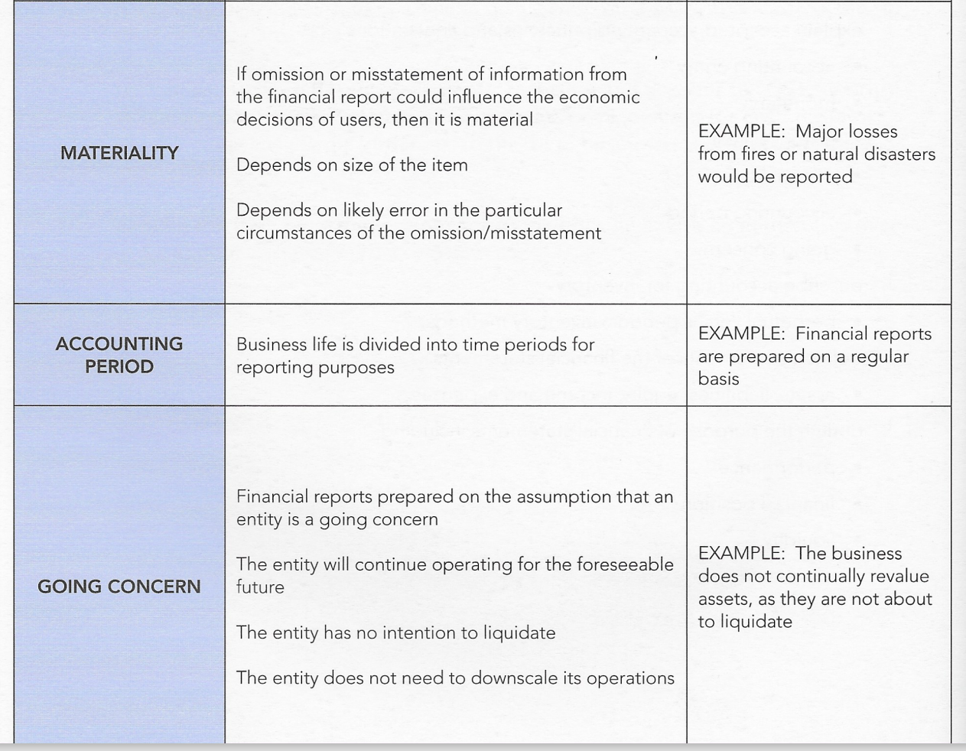

Introduction
With PowerPoint, you can create presentations and share your work with others, wherever they are. Type the text you want here to get started. You can also add images, art, and videos on this template. Save to OneDrive and access your presentations from your computer, tablet, or phone.

